Slide 1
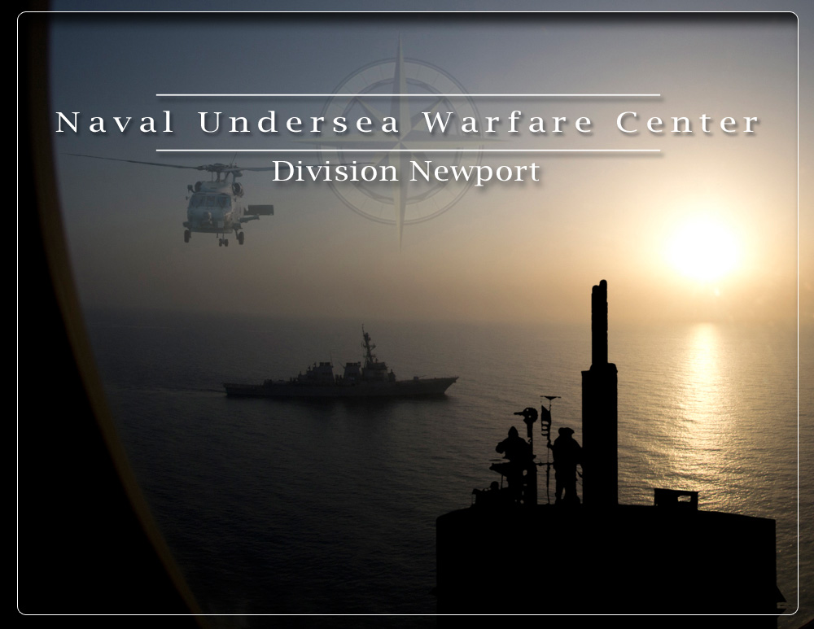

Partnerships, Collaborations
and Facilities Use
12 June 2013
Presented by:
Dr. Theresa A. Baus
Head, Technology Partnerships Office
NUWC Division Newport
Approved for Public Release Distribution is Unlimited

Slide 2
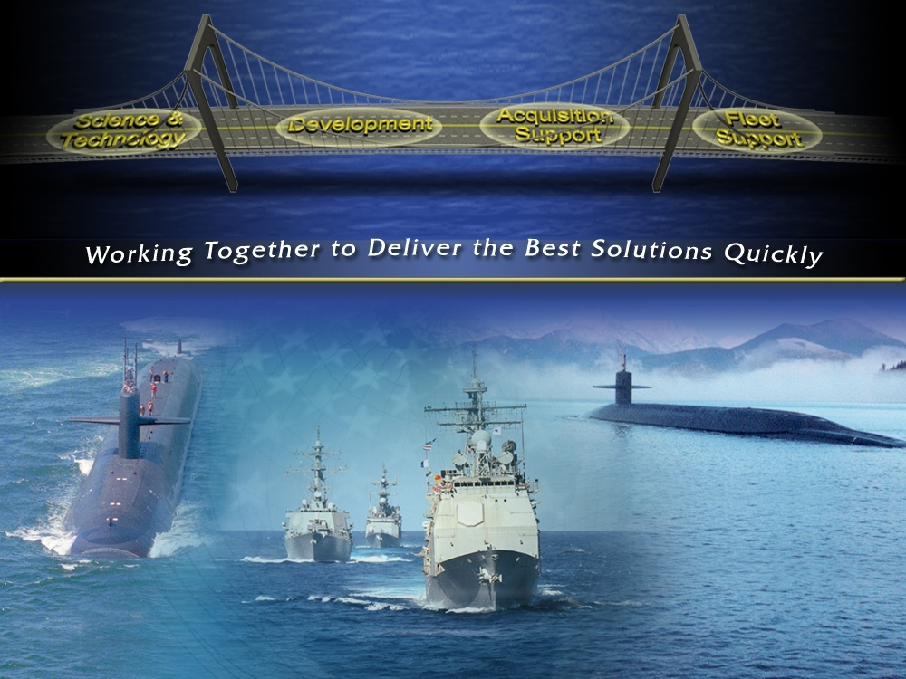
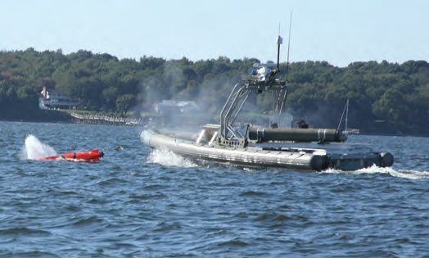
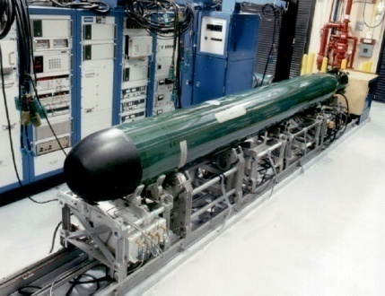

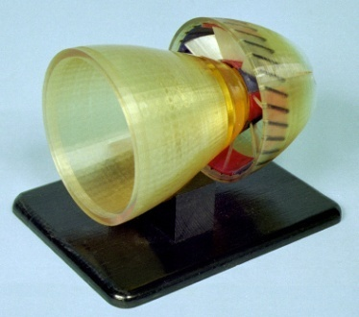
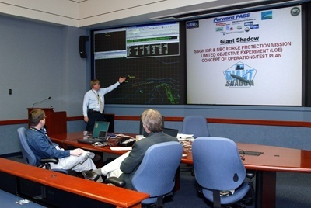
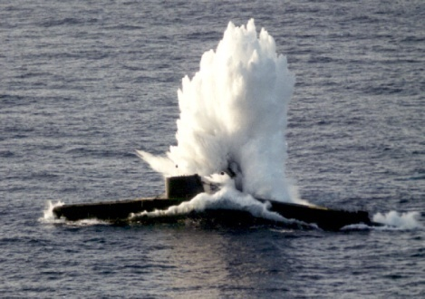
A Bridge from Concept to Capability
Warfare Centers
Innovation
Development
Acquisition
Research
Life-cycle Support
Prototyping
Test & Evaluation
Undersea Warfare Analysis
Partnering with Industry and Academia to Deliver Systems from Concept to Capability
Notes:
At Division Newport we use a bridge to depict the wide span of our work.
From the conceptual work of science and technology on the left, such as the experimentation with super-cavitating high speed vehicles depicted here, through support for our deployed systems.
We continuously assess and evolve our technical leadership and capability to meet priority needs of future undersea warfare .
We move capabilities and products across the bridge into the Fleet where our Sailors use them.

Slide 3
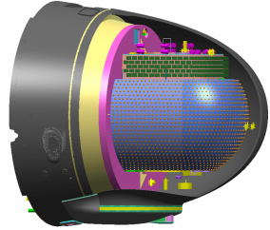
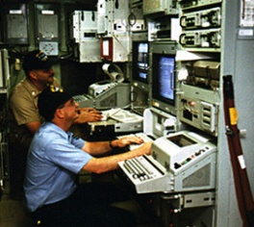
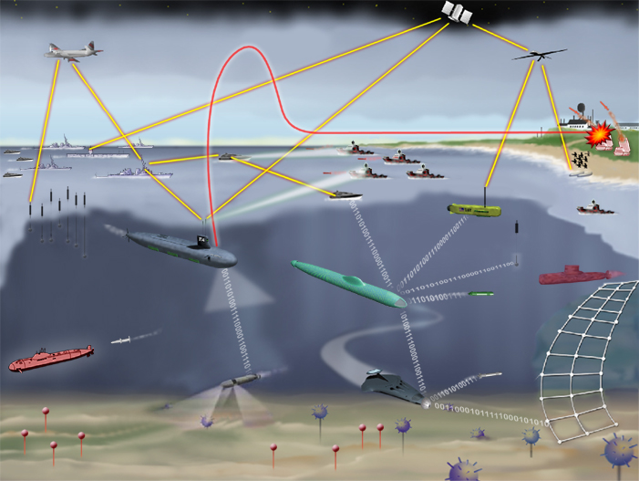
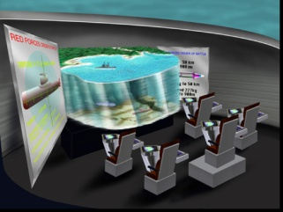
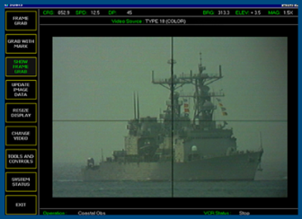
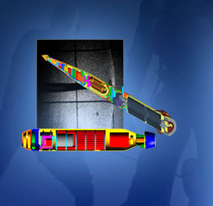

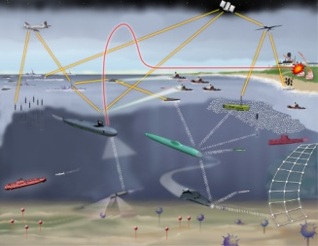

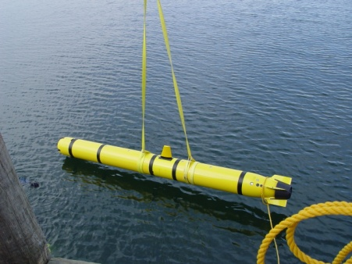
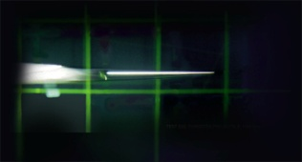
Division Newport
Areas of Expertise
The Navy After Next
Sensors & Sonar
Launchers
Communications
Transducer Technology
Signal Processing
Hull & Towed Arrays
Fiber Optic & Laser Sensor
External Launchers
Undersea Launch & Recovery
Implosion
Underwater
Communications
Adaptive & Novel Antennas
Comms at Speed & Depth
Info Assurance
USW Combat
Systems
Cognition & Decision
Support
Interoperability
Warfighter Performance
Imaging &
Electronic Warfare
Signatures & Wake
Reduction
High Res. Imaging
EW Sensing
USW Weapons
UUVs & USVs
Platform Defense
Undersea Distributed Networked Systems
Ranges
Platform Defense
Littoral Targeting
Exploitation
G&C
Design & Analysis
Propulsion
Autonomy
Long Endurance Power Sys.
Multi-Vehicle Collaboration
Biomimetic Vehicles
Decoy & Deception
Soft Kill technologies
Countermeasures
Performance Analysis
Operations
Analysis and Research
Multi-Phenomenology
Sensor Field
Coatings: Biofouling & Anti-Corrosion
Marine Mammal Behavior
Automated Reconstruction & Analysis
Portable Ranges
Notes:
As an research, development, test and evaluation activity we very focused on the future.
We have a robust science and technology program encouraging innovation and concept formulation. This slide depicts many of the efforts underway as we look at hardware, software, networked systems, human interaction and human/machine interfaces.
As innovators, we have developed numerous products that significantly improve warfighting capabilities, as evidenced by the many patents awarded to our scientists and engineers.
Over the past five years alone, NUWC personnel have been granted 330 patents covering a full range of technologies.
We will continue our work to meet the USW challenges of today and tomorrow to keep the US Navy’s USW capabilities the strongest in the world.

Slide 4

TECHNOLOGY PARTNERSHIPS
OFFICE (TPO)
Facilitates use of Division Newport intellectual capital and assets including:
    Facilities
    Equipment
    Expertise
Small Business Innovation Research (SBIR) & Small
Business Technology Transfer (STTR) programs
S&T Broad Agency Announcements (BAAs)
Leveraging Partnerships and Collaborations to
Enhance Capabilities for the Warfighter

Slide 5

Technology Partnerships Office (TPO)
Assets available for commercial use
Partnership and Collaboration Mechanisms
  Cooperative Research and Development Agreements (CRADAs)
  Work for Private Party agreements
  Patent License agreements

Slide 6


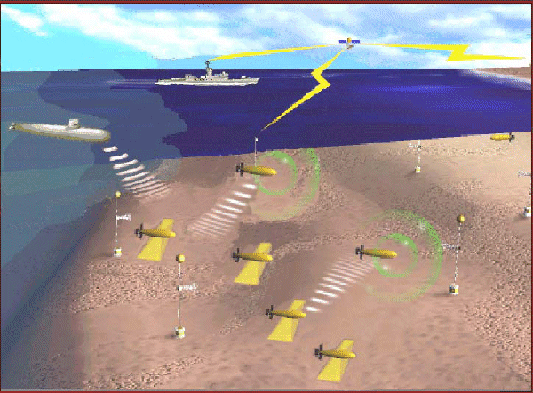

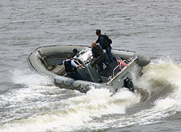
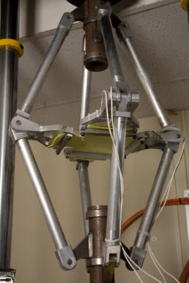

Cooperative Research & Development Agreements (CRADAs)
Agreements between DIVNPT and one or more non-Federal parties to perform cooperative & mutually beneficial R&D consistent with the DIVNPT mission
DIVNPT may provide personnel, services, facilities and equipment
Non-Federal Collaborator may provide all of the above, plus funds to DIVNPT
Preference for small businesses and for businesses agreeing to manufacture products substantially in the U.S.
Intellectual Property (IP) rights are covered in the agreements
Commercialization of a
Wireless Platform Technology
Parallelization of Decision
Support Software
Test and Design of Inflatable
Structures for Rigid Inflatable Boats

Slide 7
Navy Potential Contractor CRADA
(NPC CRADA)
Establishes need to know to gain clearance
Replaces NPC program no cost contract agreements
Company continues development of product or service and provides yearly report on progress
Division files paperwork with DSS that starts clearance process
Three years duration
Up to SECRET

Slide 8
NPC CRADA Topic Examples
Acoustic Window Materials
Geospatial Information Systems
Network-Centric Imagery
Broadens pool of contractors with ability to
address Navy technical challenges

Slide 9
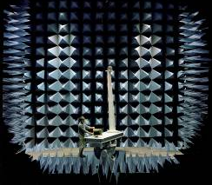
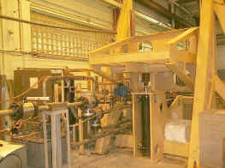
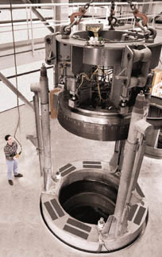
Work for Private Parties (WPP)
Provides private party access to Government facilities and expertise
Non-collaborative agreement
Private parties pay the Government & must recover all costs of use of the facility and associated Government labor
References for details:
  10 USC 2539B (Test Services)
  10 USC 2563 (Engineering Services)
  10 USC 2681 (AUTEC Range Services)
Cannot compete with industry –
Government has to be the only source
for the work/services required
Anechoic Chamber
Survivability Test Facility
Acoustic Pressure Test Facility

Slide 10
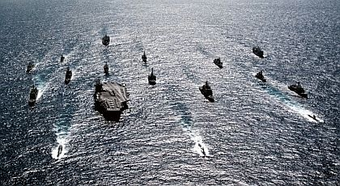
Teaming with NUWCDIVNPT in Response to a Solicitation
Division assets available for teaming
Non-binding Letter of Intent provided
CRADA, WFPP or direct funding
Division must preserve its Technical Agent role for Navy
  May not be able to participate

Slide 11


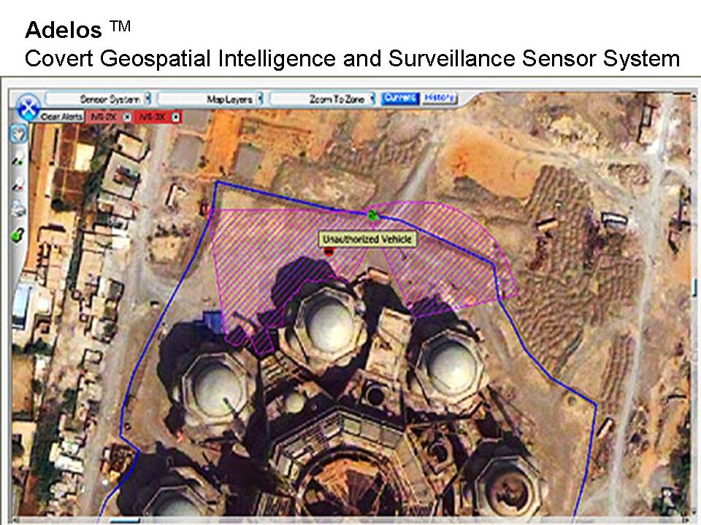
Patent License Agreements
Dual use commercialization leverages
NUWC’s R&D
Reduced risk
Exclusive and non-exclusive licenses available
CRADA in conjunction to support transition of know-how for development of commercials products
To date, NUWCDIVNPT has licensed over 120 patents

Slide 12
Science and Technology Broad Agency Announcement
(S&T) BAA
Center- wide BAA with S&T focus
Always ‘open’ invitation to submit proposals
Working to have posting by end of CY 13
Will be posted on www.fedbizopps.gov

Slide 13
S&T BAA
Detailed Requirements
Less
More
“Center-wide”
BAA
“Topical”
BAA
Unsolicited
Proposals
RFP
TPO managed
Department
managed
www.fedbizopps.gov

Slide 14
Resources for Companies
RIEDC
  Procurement Technical Assistance Center (PTAC)
    www.riptac.com
  Rhode Island Manufacturing Extension Service (RIMES)
    www.rimes.org
DoD Partnership Intermediary TechLink
  techlinkcenter.org
Federal Laboratory Consortium for Technology Transfer
  www.federallabs.org

Slide 15
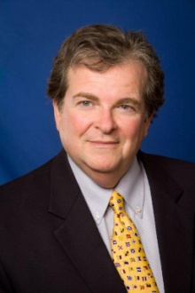


TPO Points of Contact
  Technology Transfer Coordinator
  Mike Larkin, michael.j.larkin@navy.mil
  (401) 832-8720
  SBIR/STTR Program Coordinator
  Jack Griffin, john.f.griffin@navy.mil
  (401) 832-7283
  University & Industrial Programs
  Dr. Greg Jones, gregory.b.jones1@navy.mil
  (401) 832-1681
Mike Larkin

Slide 16
  Dr. Theresa A. Baus
  Head, TPO
  Theresa.Baus@navy.mil
  (401) 832-8728

